Slide 1
Project 6 Deploy a Static website in S3 directly.
Create Static Website Files
Create an S3 Bucket
Upload Website Files
Enable Static Website Hosting
Make Bucket Public (Bucket Policy)
Access Your Website

Slide 2
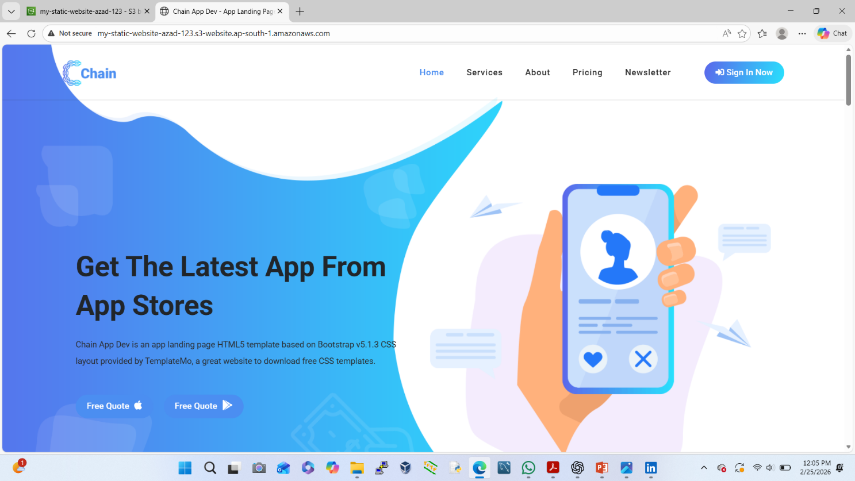
Create Static Website Files
On our local system, create these files:
<!-- ***** Logo Start ***** -->
<a href="index.html" class="logo">
<img src="assets/images/logo.png" alt="Chain App Dev">
</a>
<!-- ***** Logo End ***** -->
<!-- ***** Menu Start ***** -->
<ul class="nav">
……….etc

Slide 3
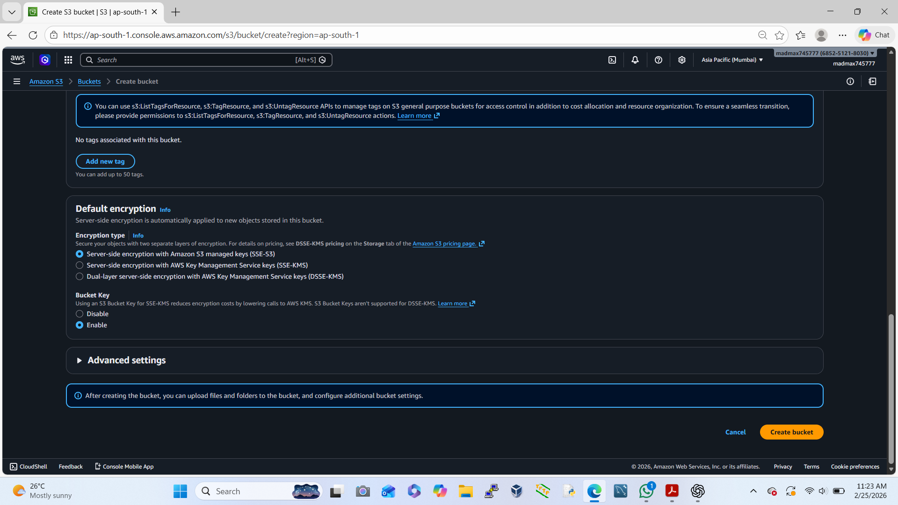
Create an S3 Bucket
Login to AWS Console
Go to S3 → Create bucket
Bucket name (must be unique):
my-static-website-azad-123
Region: Any (ex: ap-south-1)
Uncheck: Block all public access
Acknowledge warning
Click Create bucket

Slide 4
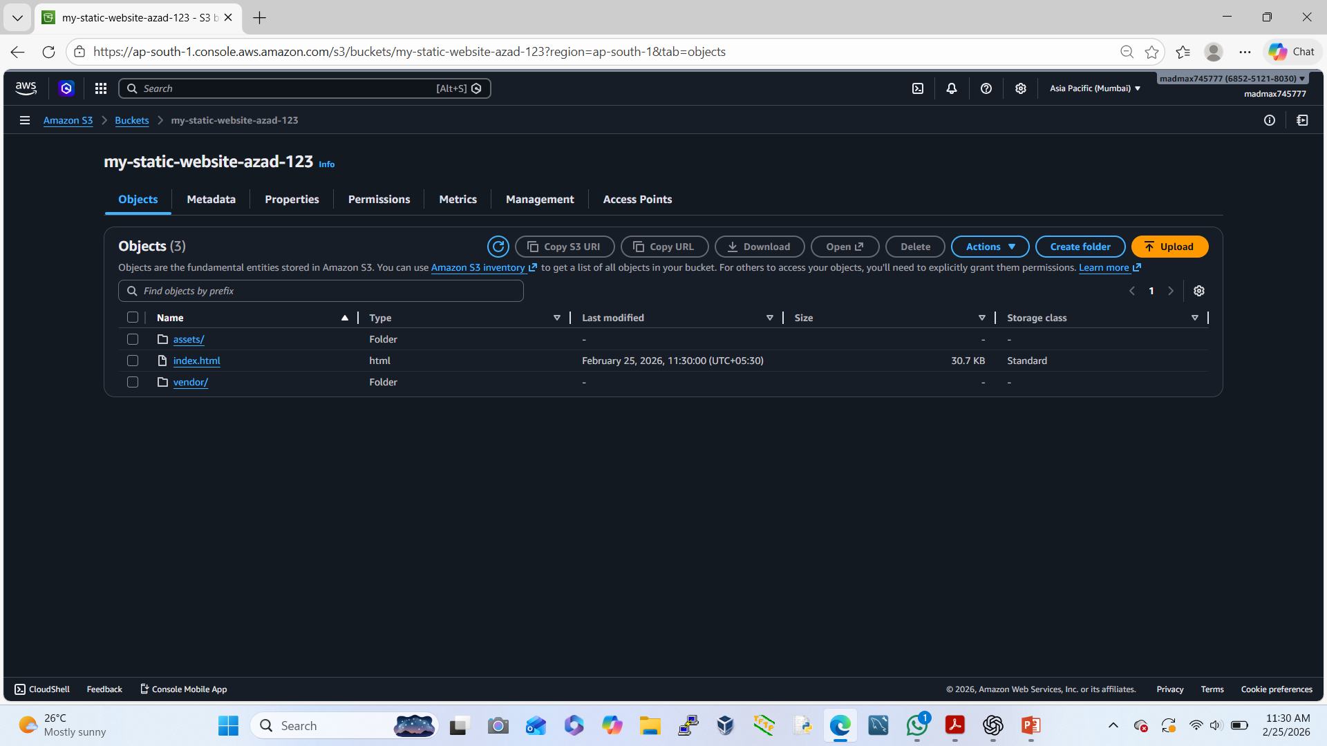
Upload Website Files
Open your bucket
Click Upload
Upload:
✔ assets/
✔ index.html
✔ vendor/
Click Upload

Slide 5
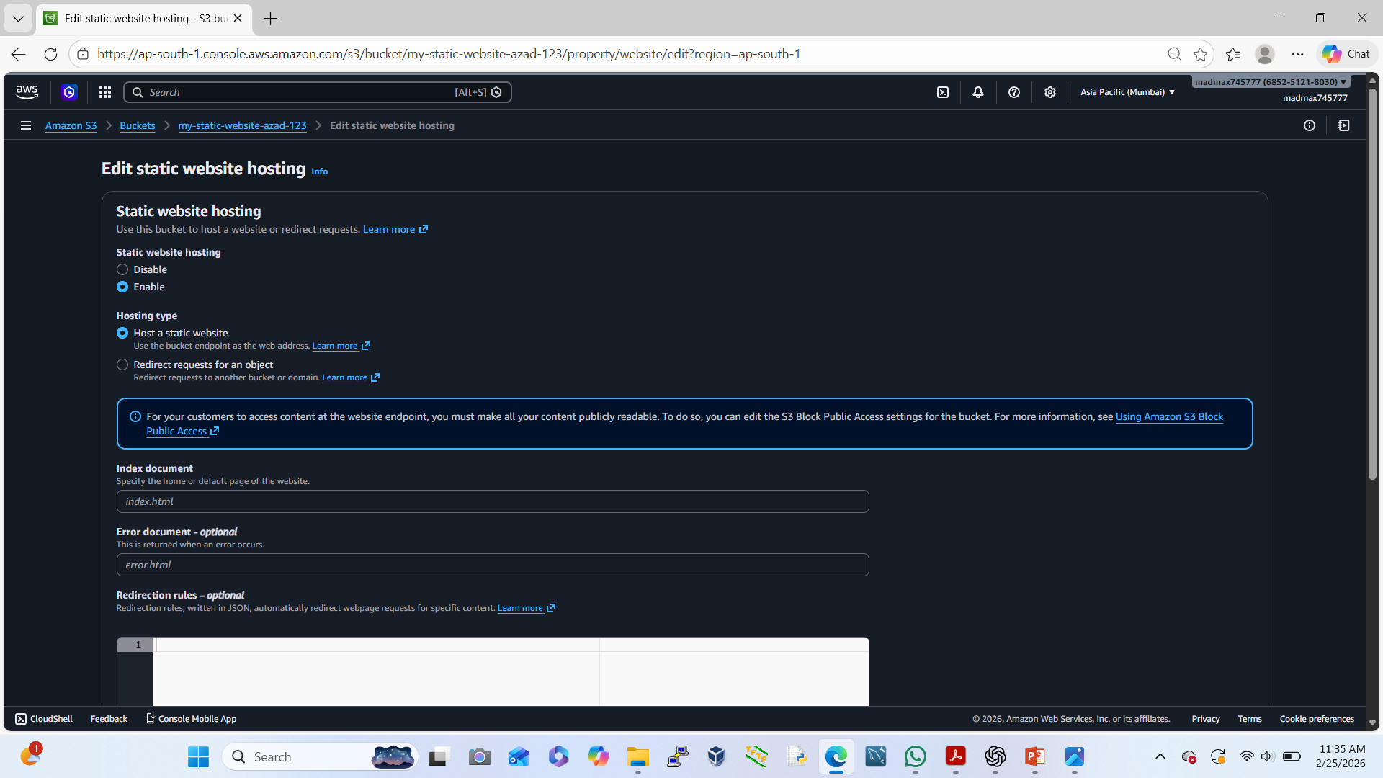
Enable Static Website Hosting
Open bucket → Properties
Scroll to Static website hosting
Enable it
Choose:
✔ Index document: index.html
Save changes
👉 we’ll get a Website endpoint URL (copy it).

Slide 6
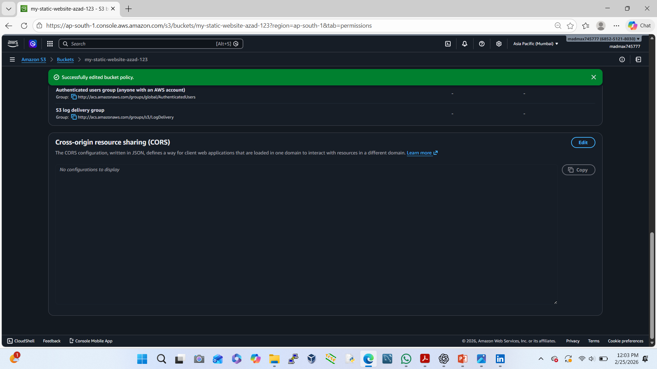
Make Bucket Public (Bucket Policy)
Go to Permissions → Bucket policy
Paste this policy (bucket name 👇)
{ "Version": "2012-10-17", "Statement": [ { "Sid": "PublicReadGetObject", "Effect": "Allow", "Principal": "*", "Action": "s3:GetObject", "Resource": "arn:aws:s3:::my-static-website-azad-123/*" } ] }

Slide 7
Access Your Website
Open browser → paste S3 Website Endpoint URL
https://my-static-website-123.s3-website.ap-south-1.amazonaws.com

